Slide 1

WeCook
Cooking. Connected.
Team 04:
Avani Choudhary (Lead Designer)
Alessandro D’Urso (Architecture Lead)
Daniel Moran (Scrum Master & Planning Lead)

Slide 2
What is WeCook?
WeCook.
A Social Media platform for the college student, Grandmother, and experienced Chef alike.
WeCook provides one, consolidated platform to share, discuss, and improve recipes.

Slide 3

Why our Platform?
Why WeCook?
amateur cooks and college students can find reliable and easy to access recipes
the more experienced can share their knowledge and give input to other posters, while discovering new tricks along the way
families can preserve their generational recipes and still keep them private

Slide 4
System Overview

Slide 5
System Recipe
The system is composed of a database, account settings, user messaging, and cookbook functions (creating, editing, publishing)
The database will use Amazon Web Services, (AWS) particularly, Amazon Aurora, as it is compatible with MySQL (as per requirements).
The database will consist of tables for Public/Private Cookbooks, and User account information.
Cookbooks will store recipes as substructures
Messages will be encrypted end-to-end
All Cookbook, Account, and Setting edits will be kept synchronized between server and client at all times.
1
How are we cooking up WeCook?

Slide 6
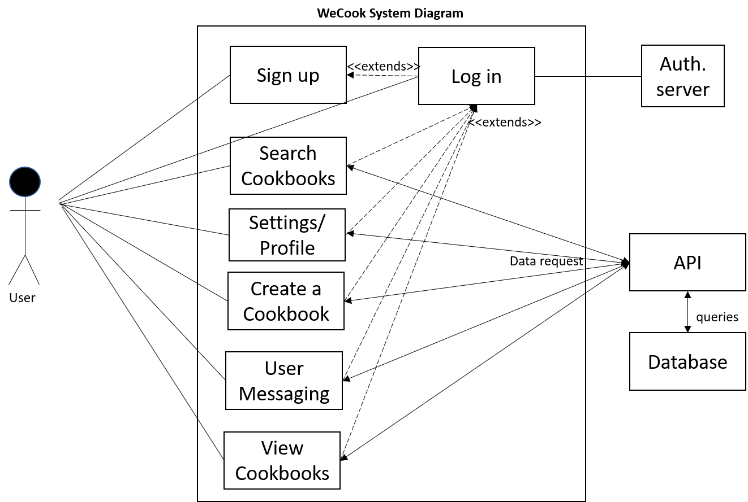
System Diagram
The User can interact with the main functions of the application
The API receives data requests from app functions, and queries the database.
The Database receives queries from the API, and returns requested information.
The Authentication server receives queries from signup/login functions, and returns if the user is valid or not.
More lines than your measuring cup!
Actors: The User, API, Database, and Authentication server

Slide 7
System Architecture

Slide 8
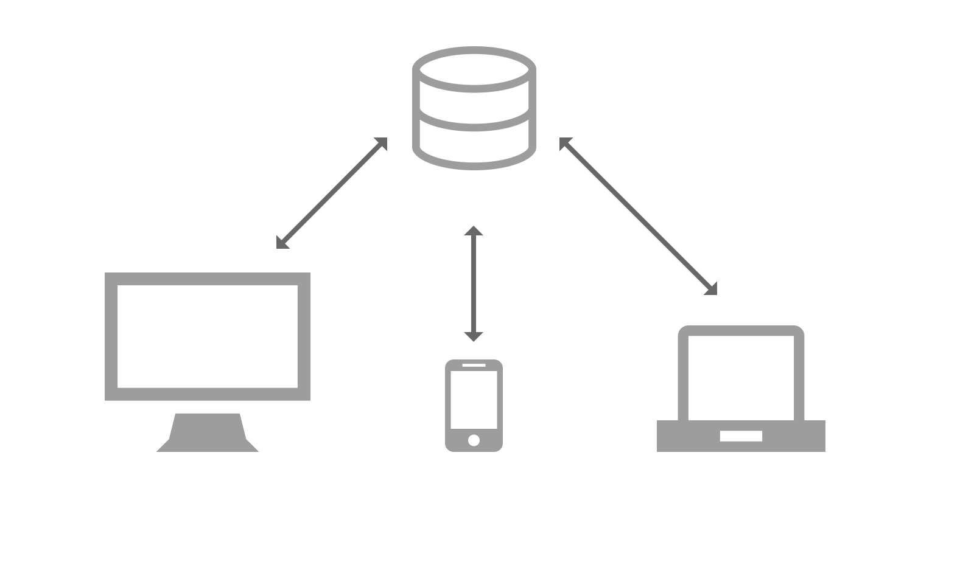
System Architecture
Client-server architecture
Cookbooks and Recipes stored in DB
Client retrieves from server for display
Changes made client-side will be pushed to server
Real time changes made through API
No middle tier between client and server besides the API
Client-Server … No, not that kind of server.

Slide 9
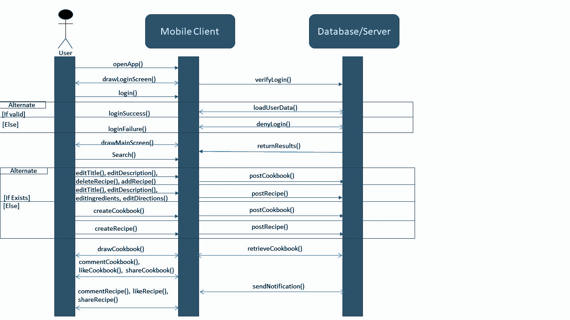
Sequence
Diagram

Slide 10
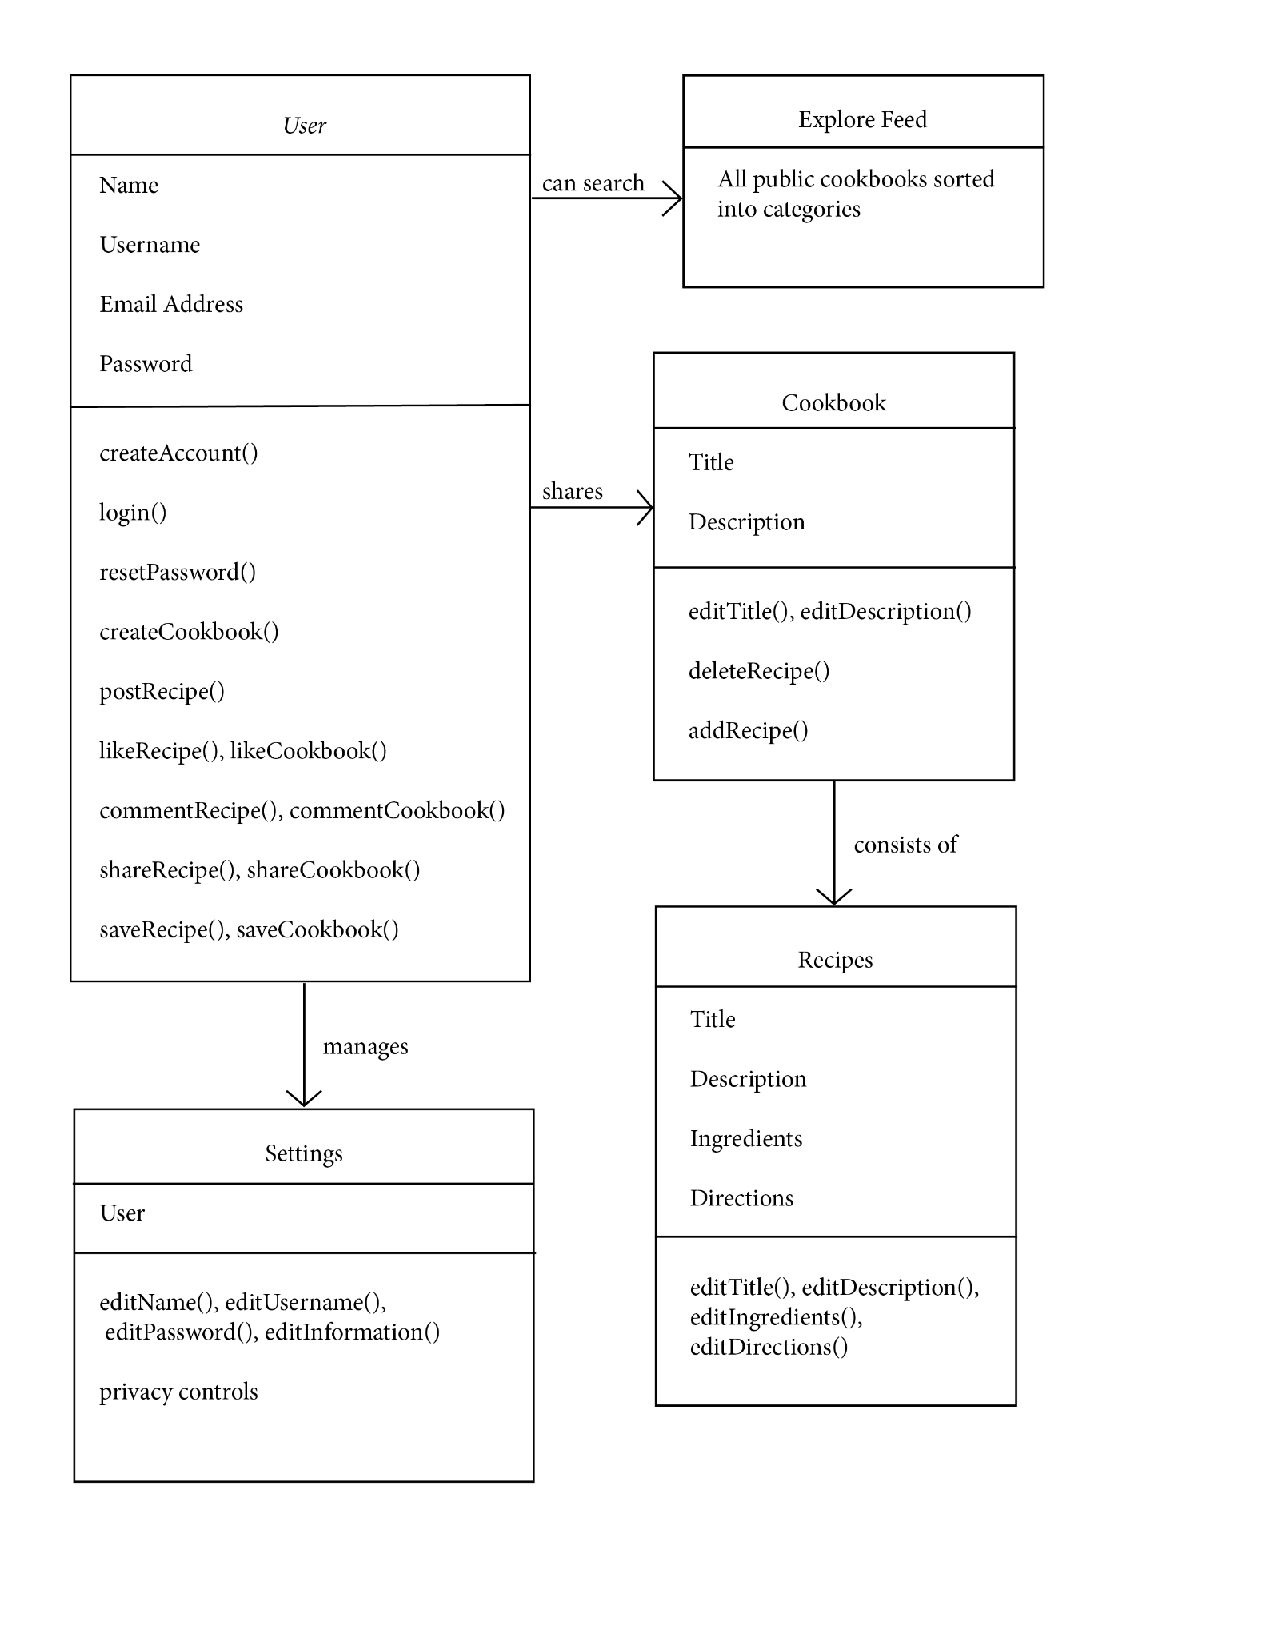
Class
Diagram

Slide 11
Design Patterns

Slide 12


“Factory” Method
Designing interfaces to instantiate later
Larger parent classes
Sub-classes will inherit parent interface
Example: Public v. Private Cookbooks
Cookbook parent class
Public and Private are inheriting child classes

Slide 13
“Command” Pattern
Parameterization of requests into objects
Object contains all information about the request
Example: Updating a Cookbook
Requests are then passed as method arguments
Allows for delaying or queuing user requests
Adds support for “undoing” requests

Slide 14
Frameworks

Slide 15
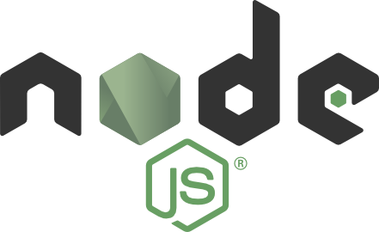
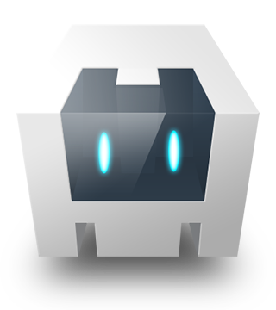
What’s in the oven already?
Node.js
“Node.js is an open-source, cross-platform, back-end JavaScript runtime environment that runs on the V8 engine and executes JavaScript code outside a web browser. Node.js lets developers use JavaScript to write command line tools and for server-side scripting—running scripts server-side to produce dynamic web page content before the page is sent to the user's web browser.” (Wikipedia)
Apache Cordova
Apache Cordova is an open-source mobile development framework. It allows for the use of HTML5, CSS3, and JavaScript for cross-platform development. Applications execute within wrappers targeted to each platform (iOS, Android, Web-Browser).

Slide 16
Mock-Ups

Slide 17
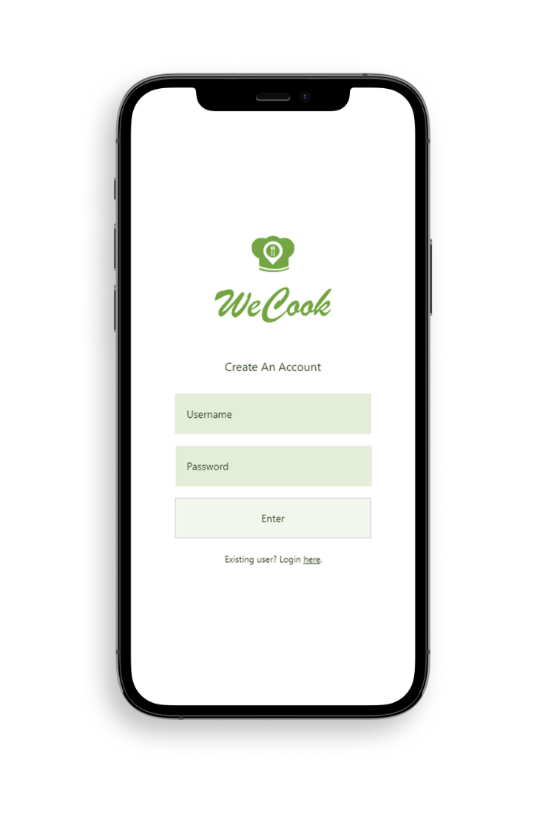
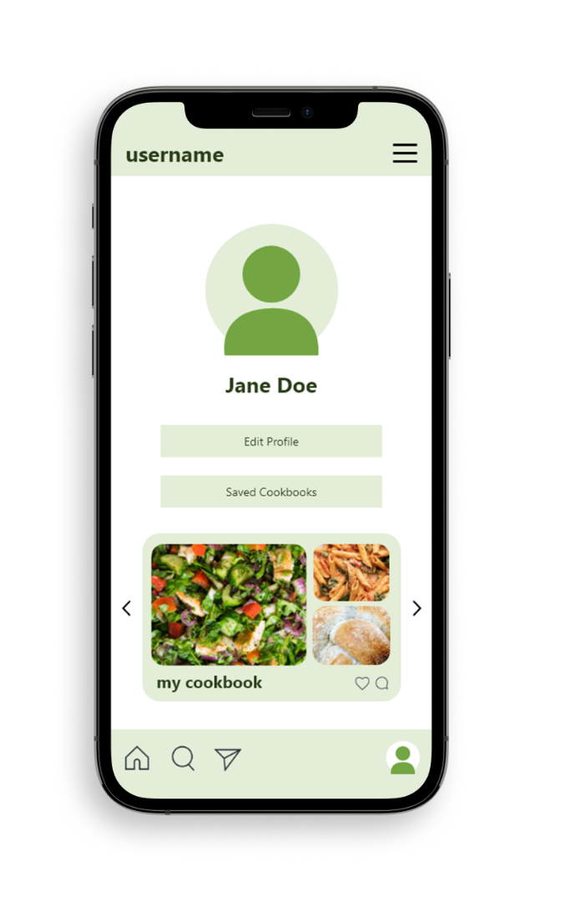
https://xd.adobe.com/view/d1401480-d32d-4d7c-b266-fc9b4a61290b-8413/screen/362e74a7-99ca-4a8b-8081-8d623aa8640d

Slide 18
Questions?

Slide 19

GitHub Repository
https://github.com/DanielM-CSCMiami/CSC431-FinalProj

